Slide 1



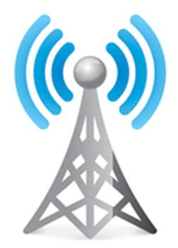
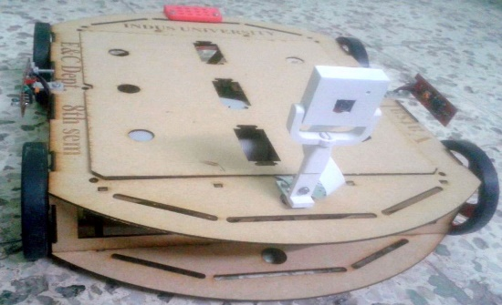
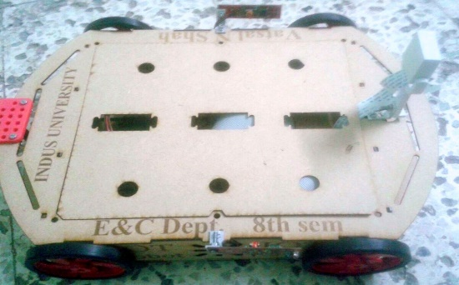

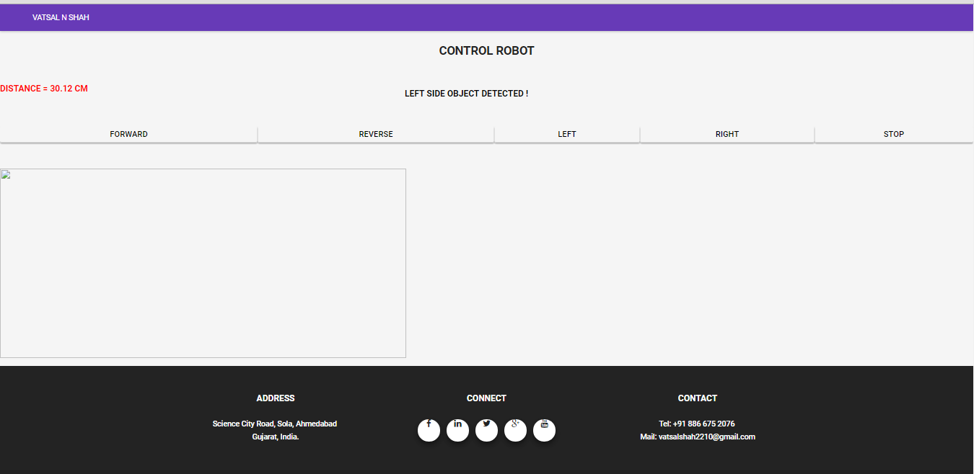
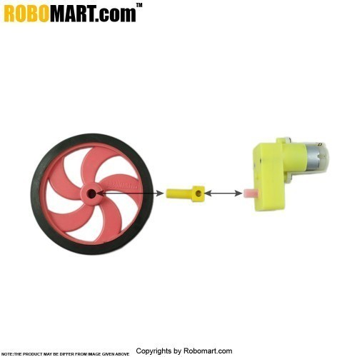
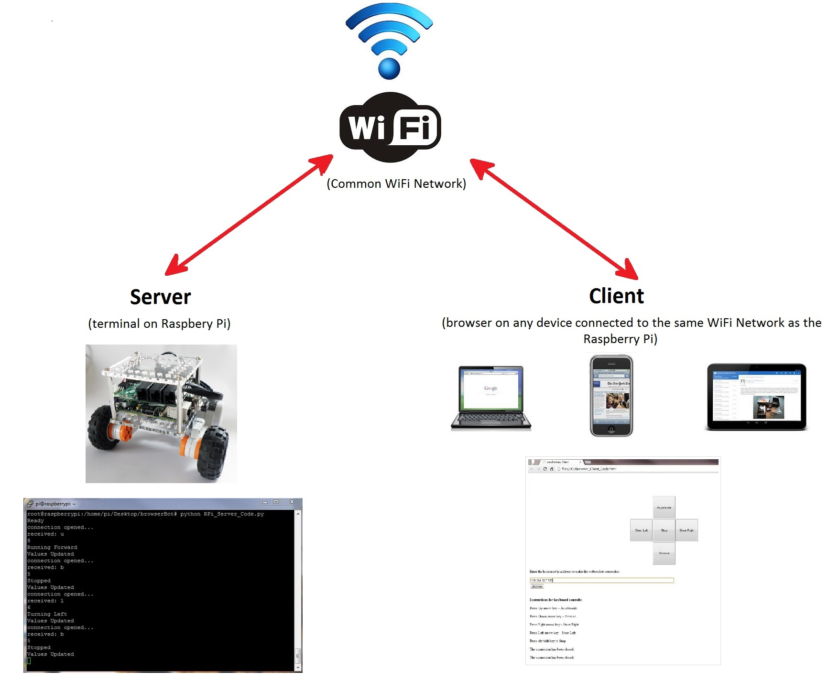
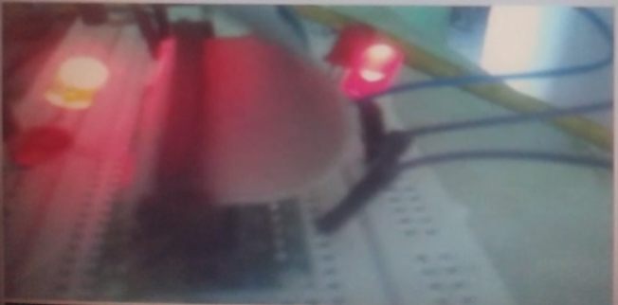
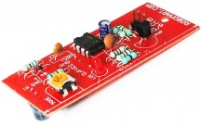
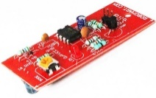
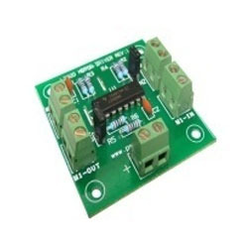
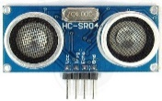
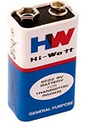
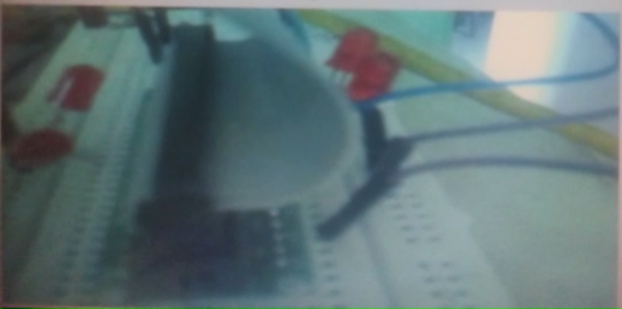
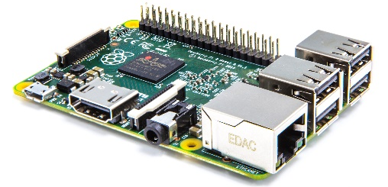
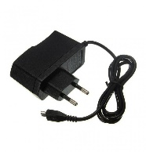
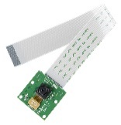
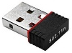
















IOT ROBOT
VATSAL N SHAH : IU1241090055
ELECTRONICS & COMMUNICATION DEPARTMENT, INDUS UNIVERSITY
Group No: 1
abstract
Block diagram
Set up & results
The purpose of this project is to control robot with an interface board of the Raspberry Pi, sensors and software to full fill real time requirement.
Controlling DC motors, different sensors, camera interfacing with raspberry Pi using GPIO pin.
Live streaming, Command the robot easily, sends data of different sensors which works automatically or control from anywhere at any time.
Design of the website and control page of robot is done using Java tools and HTML. This system works on IOT concept.
This will enable Raspberry Pi to be used for more robotic applications and cut down the cost for building an IOT Robot.
Find IP address of Raspberry Pi in router
In MobaXteme software Enter the Raspberry Pi IP and Login
Run Shell script of Streaming and sensor program / run startup file
Deploy WAR file to Tomcat server on Raspberry Pi by using WinSCP
Enter URL in browser to open a website
Control the Robot by different options and view Live Streaming from page
Control Robot page can be opened from Mobile/Laptop/iPad
Goto My Project link, Register/Login using Email ID & password to open control Robot page
IOT Robot Design
Server
(Raspberry Pi)
Client
(browser on any device connected to the same WiFi network as the Raspberry Pi)
7
8
7
8
11
2
3
4
5
6
1
12
1
6
introduction
5
9
Background/Motivation:
Raspberry Pi is a credit-card sized computer.
The research and development of Raspberry Pi controlled IOT based robot.
IOT is Internet of thing where all the physical devices connects with digital systems, such as Refrigerator, TV, AC, Washing machine, Music system which can works automatically or control from anywhere.
Researched says 50 billions devices will connect by 2020.
It is connected with the Internet and robot can be controlled as per given command.
Technology:
The technologies used in the project are Java, HTML, Java Script, JSP, Ajex, JSP & Servlet.
It uses the wireless technology to communication between Raspberry Pi and user interface.
1
10
No. | Test case description | Test Result
1 | Webcam Video display | Accepted
2 | Move Forward | Accepted
3 | Move Reverse | Accepted
4 | Turn Left | Accepted
5 | Turn Right | Accepted
6 | Stop | Accepted
7 | Ultrasonic sensor reading | Accepted
8 | IR Sensor reading | Accepted
4
3
2
The block diagram for IOT Robot
Flow Chart
No. | Item | No. | Item
1 | Raspberry Pi 2 | 7 | Left Side DC Motor
2 | Wifi Dongle | 8 | Right Side DC Motor
3 | Raspberry Pi Camera | 9 | L293D Motor Driver Board
4 | 5V Adapter | 10 | 9V Battery
5 | Ultrasonic Sensor | 11 | Control from different devices
6 | IR Sensors | 12 | User Interface to Control Robot
Result Set
Future work
In the future this technology can be used in various different fields of work.
The robot can be made autonomous with the help of more sensor, gyroscope, compass and a GPS. So that it can be set to a target or a specific area where in can monitor.
Adding the Pneumatics design in Mechanical so robot can go up and down, can hold the object.
Face recognition: The robot will recognize the face images which are stored in controller and generate the alert if doesn't match.
By making above changes robot can do more functions as Open the door, Turn on/off switch, bring newspaper for user, etc.
objectives
No & Item included of Block Diagram
Used tools
To develop an IOT technology based robot, which can be controlled by a mobile devices/ computer over the Internet / Wi-Fi from anywhere at any time.
Gather system requirements
Evaluate and study the platform required for the system
Evaluate and study suitable development language, technologies and tools
Evaluate Methods of Interface
Program Raspberry Pi
Interface board for dc motors
Program Website & Control Page
Evaluate and test the system
Maintain system
references
Build and Interface Internet Mobile Robot using Raspberry Pi and Arduino by Prof. Dr. Nabeel Kadim Abid Al-Sahi, Innovative Systems Design and Engineering Vol.6, No.1, 2015.
Rasp-Pi based Remote Controlled Smart Advertising of Still and Moving Images, International Journal of Engineering and Computer Science, Volume 4 Issue 9, Sep 2015.
Design and build a Raspberry Pi robot By Stewart Watkiss, (PenguinTutor)
Cristina Turcu, Cornel Turcu, Vasile Gaitan, Merging The Internet Of Things And Robotics, Recent Researches In Circuits And Systems
Research Directions for the Internet of Things, John A. Stankovic, Life Fellow, IEEE

